Slide 1
Changelog
Changelog
V2.1 Date 6.12.23
Added new calendar and planner layouts starting on slide 21. These are not in the “layouts” dropdown, so if you delete one by mistake you will need to copy it from the template again. This keeps the layout options from getting too crowded.
Added more customizable front covers. There is an option with black text for lighter colors and an option with white text for darker colors.
Moved extra controller map and brain map assets to parts library document
Changed the divider page to be customizable.
V2.0 Date 5.15.23
Added new template pages for controller map & brain map
Updated field map to 2023-2024 “Over Under” Game
Added second title page template for additional customizability
You can delete this page from your Team’s notebook!
Christine
06/12/2023
01

Slide 2
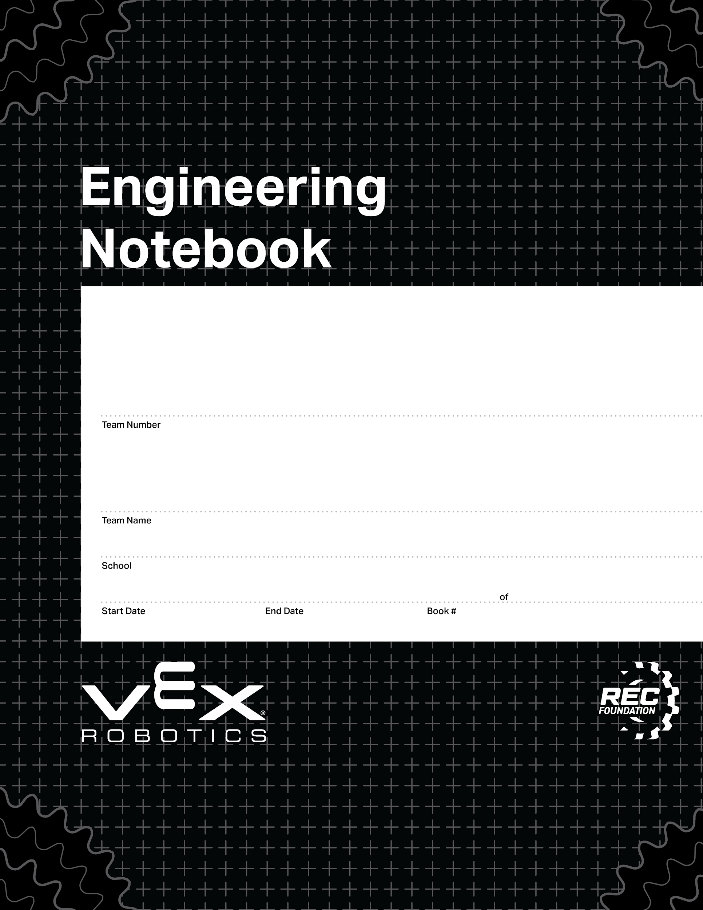
This is the basic notebook cover page.
0000
00/00/0000
00/00/0000
1
1
V2.1 Date 6.12.23

Slide 3
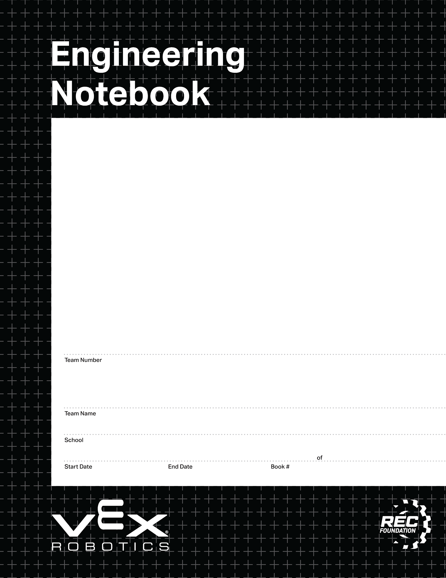
This is an alternate front page.
Place a team photo or other information here.
0000
00/00/0000
00/00/0000
1
1
V2.1 Date 6.12.23

Slide 4





16076A
犀牛望月A队
上海市西南位育中学
08/01/0000
NEVER ENDING
1
1
V2.1 Date 6.12.23

Slide 5
16076B
犀牛望月B队
上海市西南位育中学
08/01/0000
NEVER ENDING
1
1
V2.1 Date 6.12.23

Slide 6
This is an alternate front page.
Place a team photo or other information here.
Right click me and select “Change Background” and then choose your team’s favorite color!
0000
00/00/0000
00/00/0000
1
1
V2.1 Date 6.12.23

Slide 7
This is an alternate front page.
Place a team photo or other information here.
Right click me and select “Change Background” and then choose your team’s favorite color!
0000
00/00/0000
00/00/0000
1
1
V2.1 Date 6.12.23

Slide 8
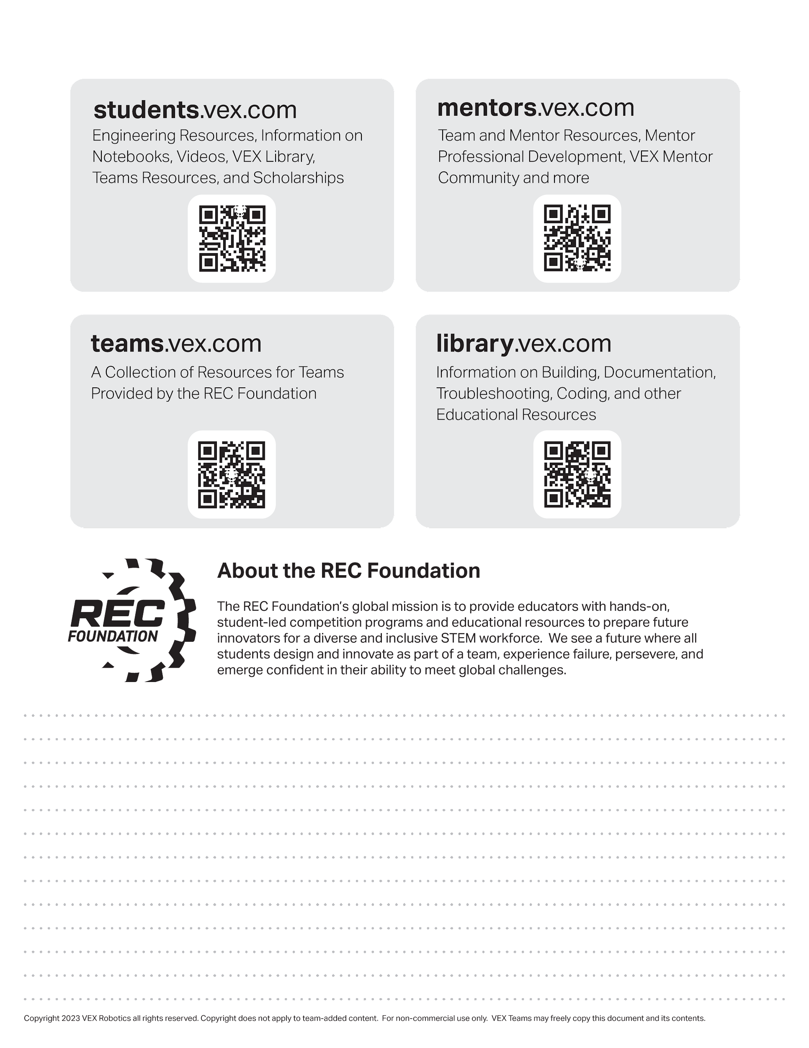
Resources
engineering.vex.com
notebooking.vex.com
coding.vex.com
Judging Rubric for Notebooks
vex.com
roboticseducation.org
VRC 2023-2024 Game - Rules & Game Video
Send suggestions and comments about these Digital Notebooks and Digital Parts
to notebooks@vex.com

Slide 9
12345 Title Title Title Date Date Date

Slide 12
Section A

Slide 17
PORT
PORT
PORT
PORT
PORT
PORT
PORT
PORT
PORT
PORT
PORT
PORT
PORT
PORT
PORT
PORT
PORT
PORT
PORT
PORT
PORT
PORT
PORT
PORT
PORT
PORT
PORT
PORT
PORT

Slide 18
BUMPER
BUMPER
BUMPER
BUMPER
STICK
STICK
STICK
STICK
BUTTON
BUTTON
BUTTON
BUTTON
BUTTON
BUTTON
BUTTON
BUTTON

Slide 21



The game objects on this page are moveable
These tri-balls are underneath the bar. They are placed on top on this slide so they be can moved.

Slide 22
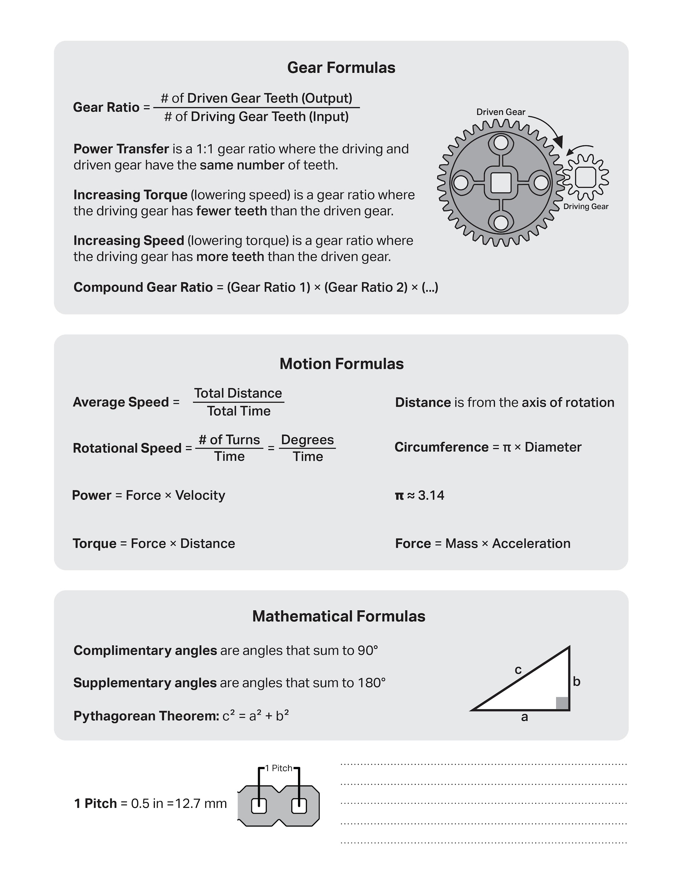

Slide 23
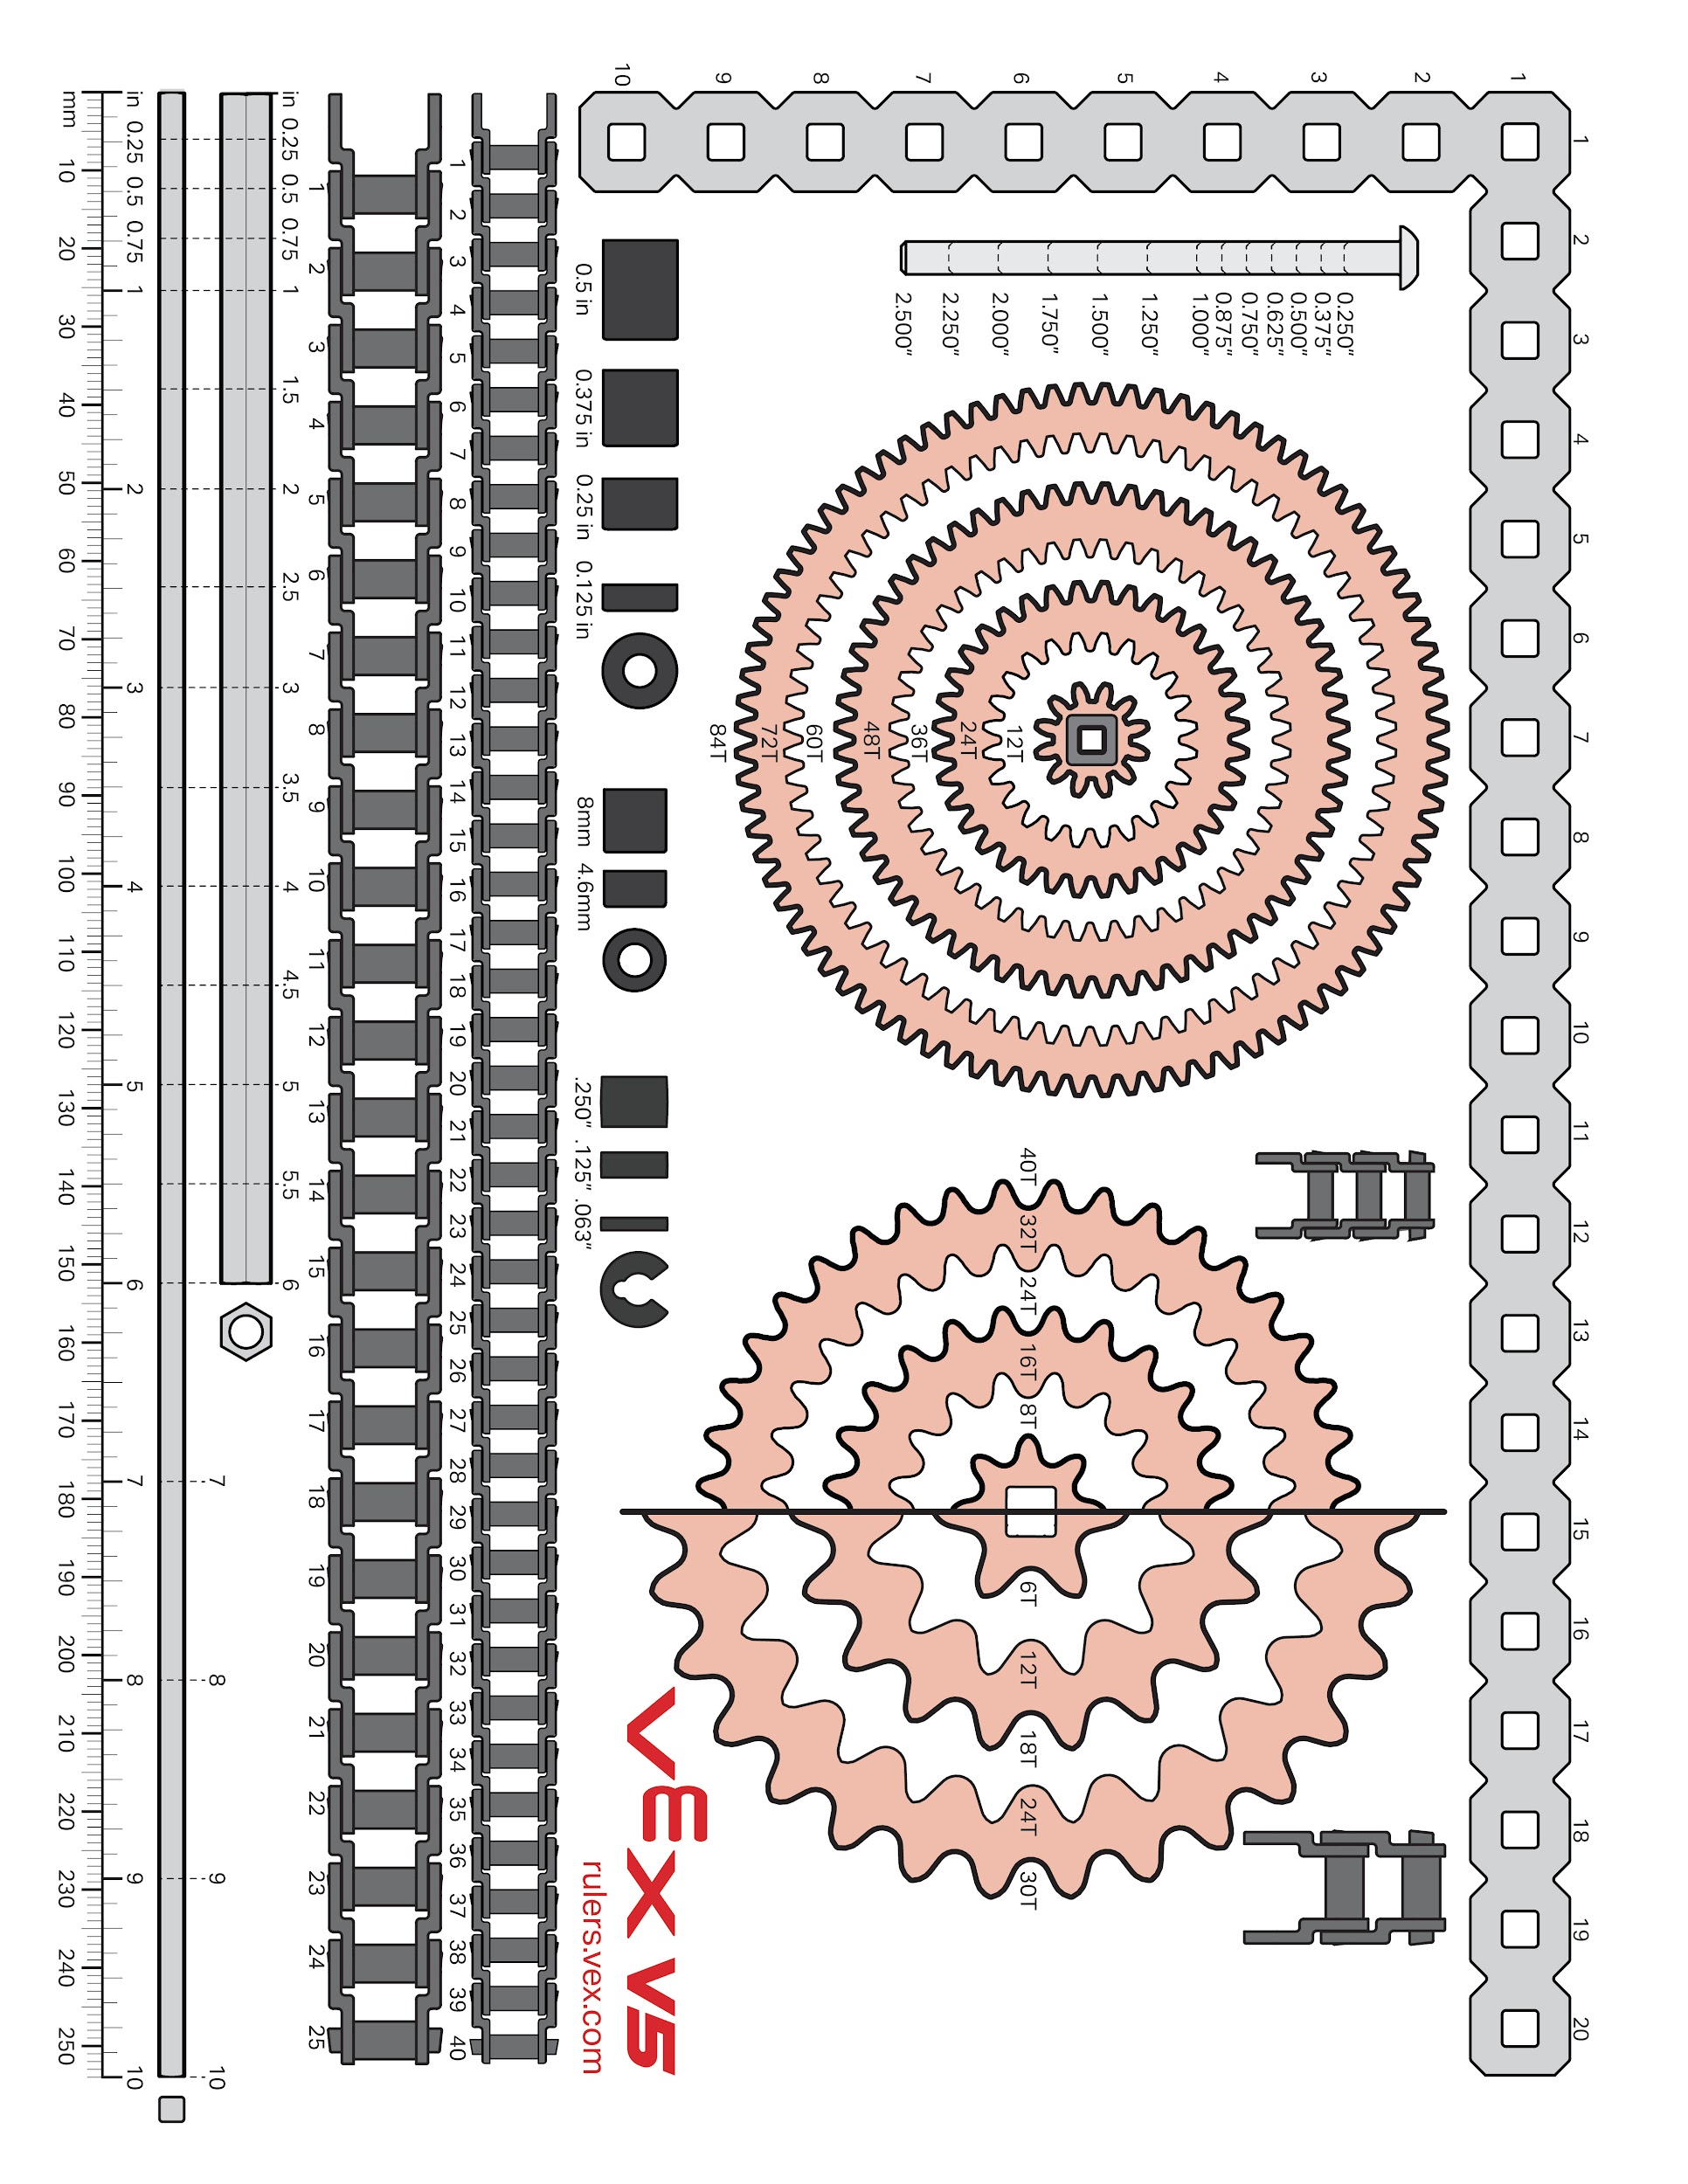

Slide 24
Week of: MM/DD/YYYY

Slide 25
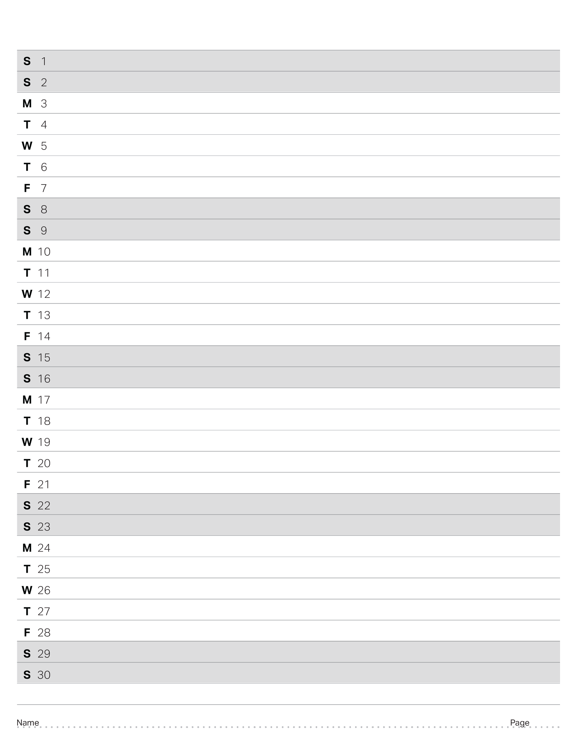
April 2023

Slide 26
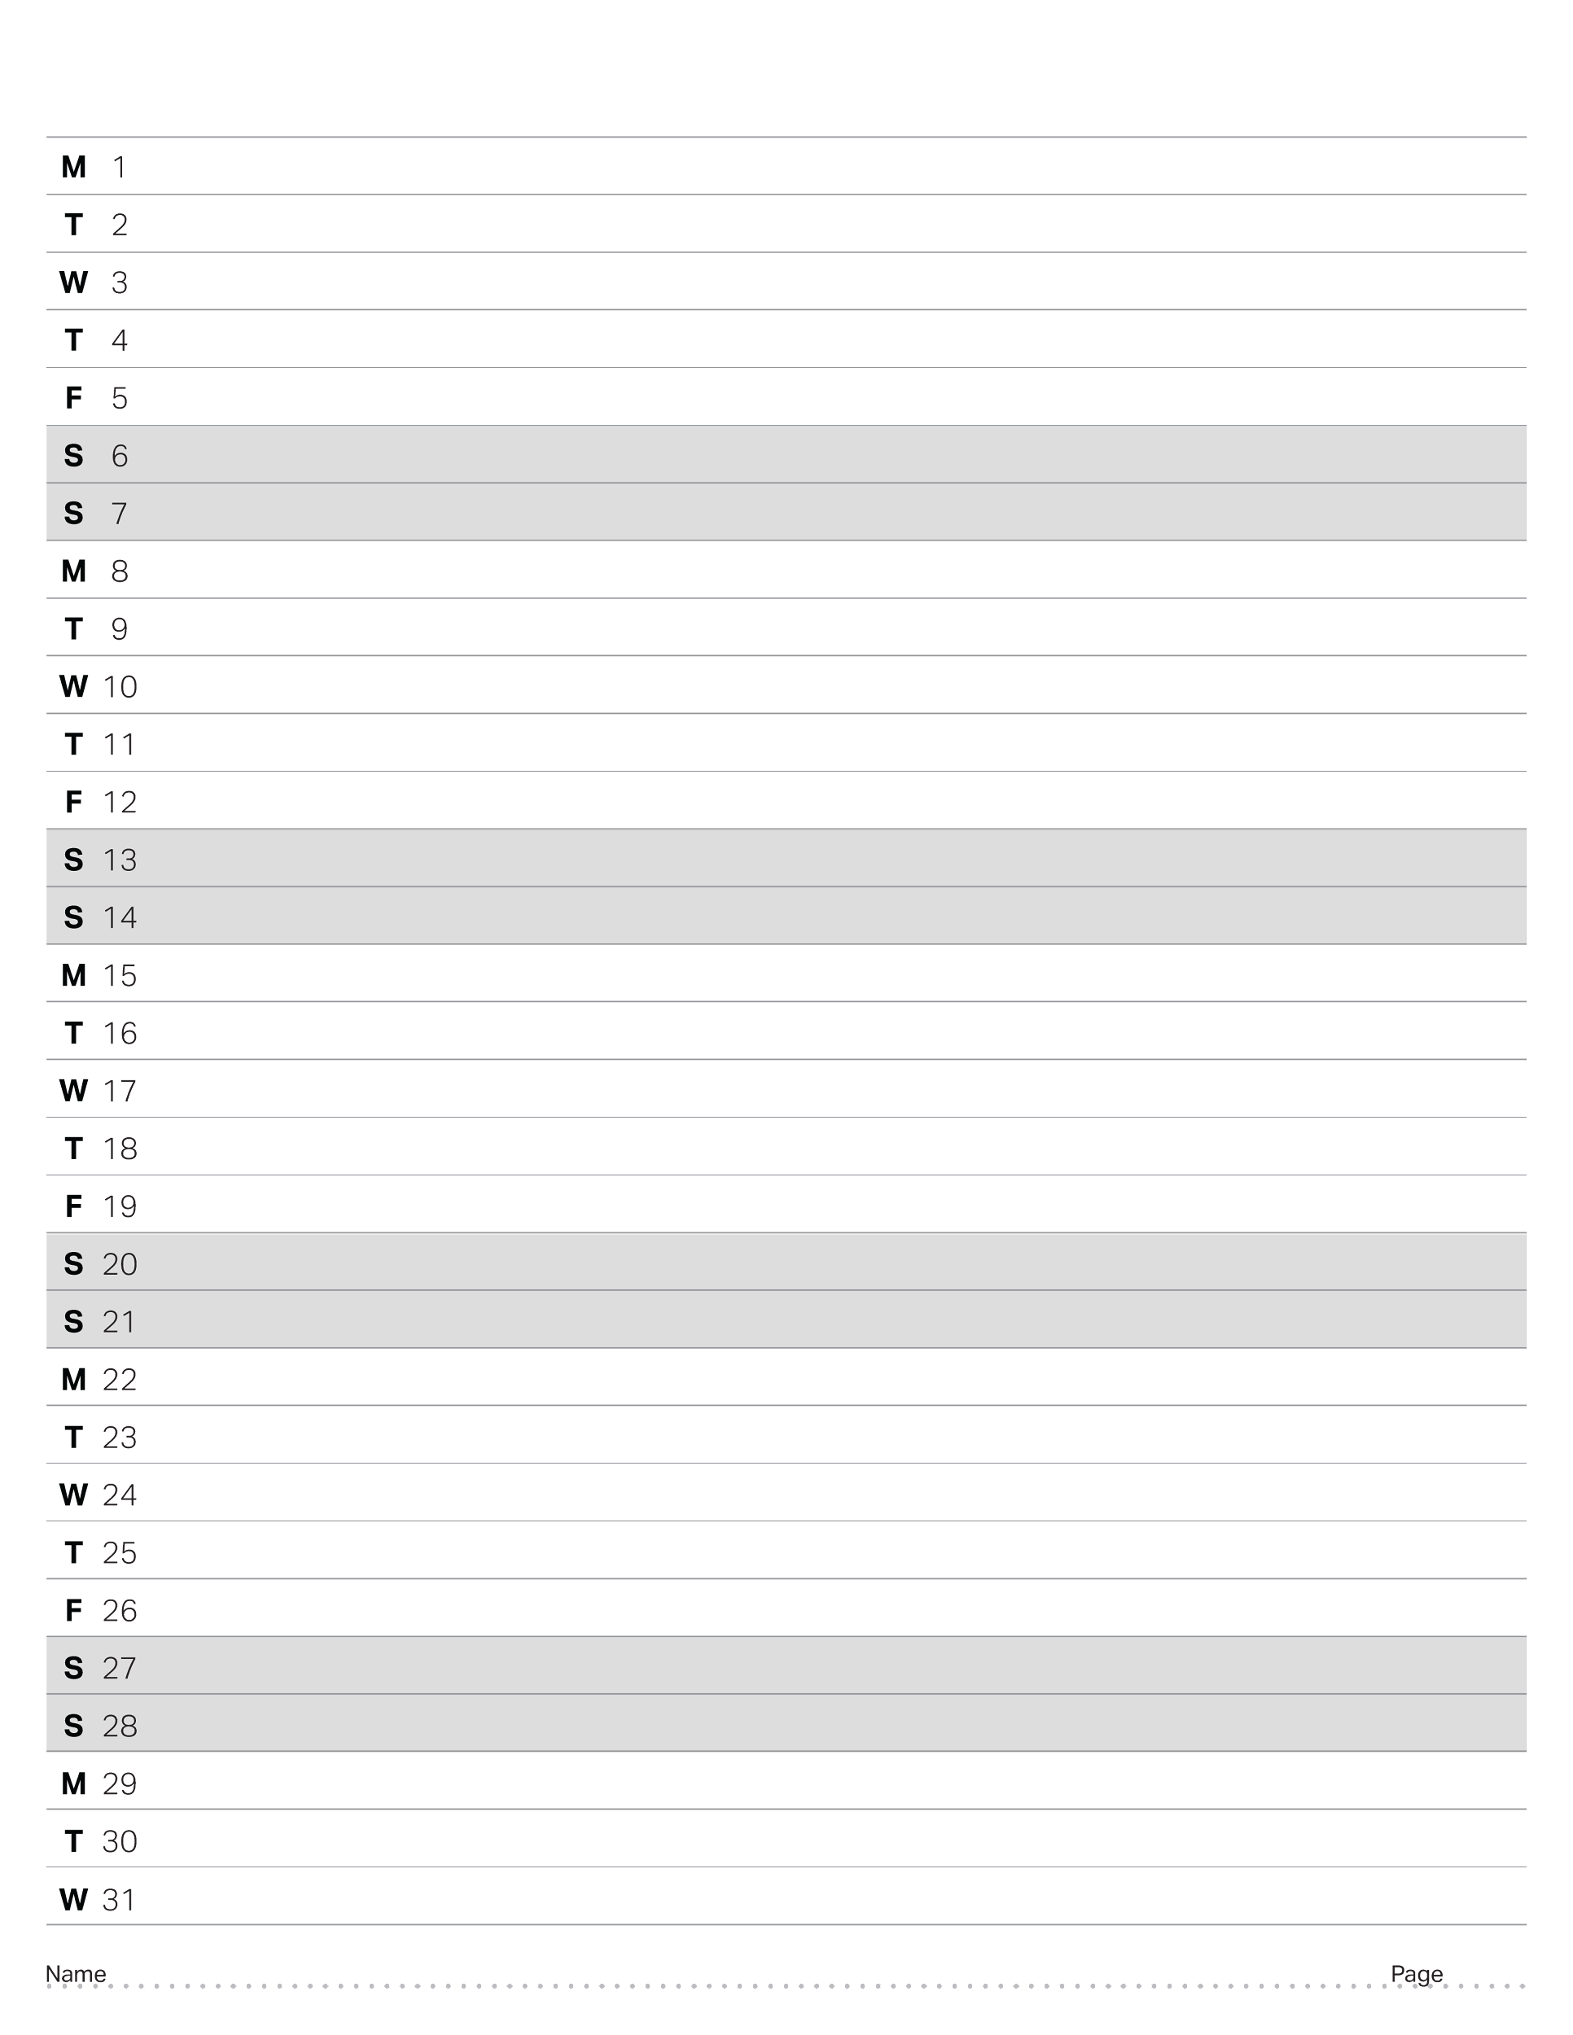
May 2023

Slide 27
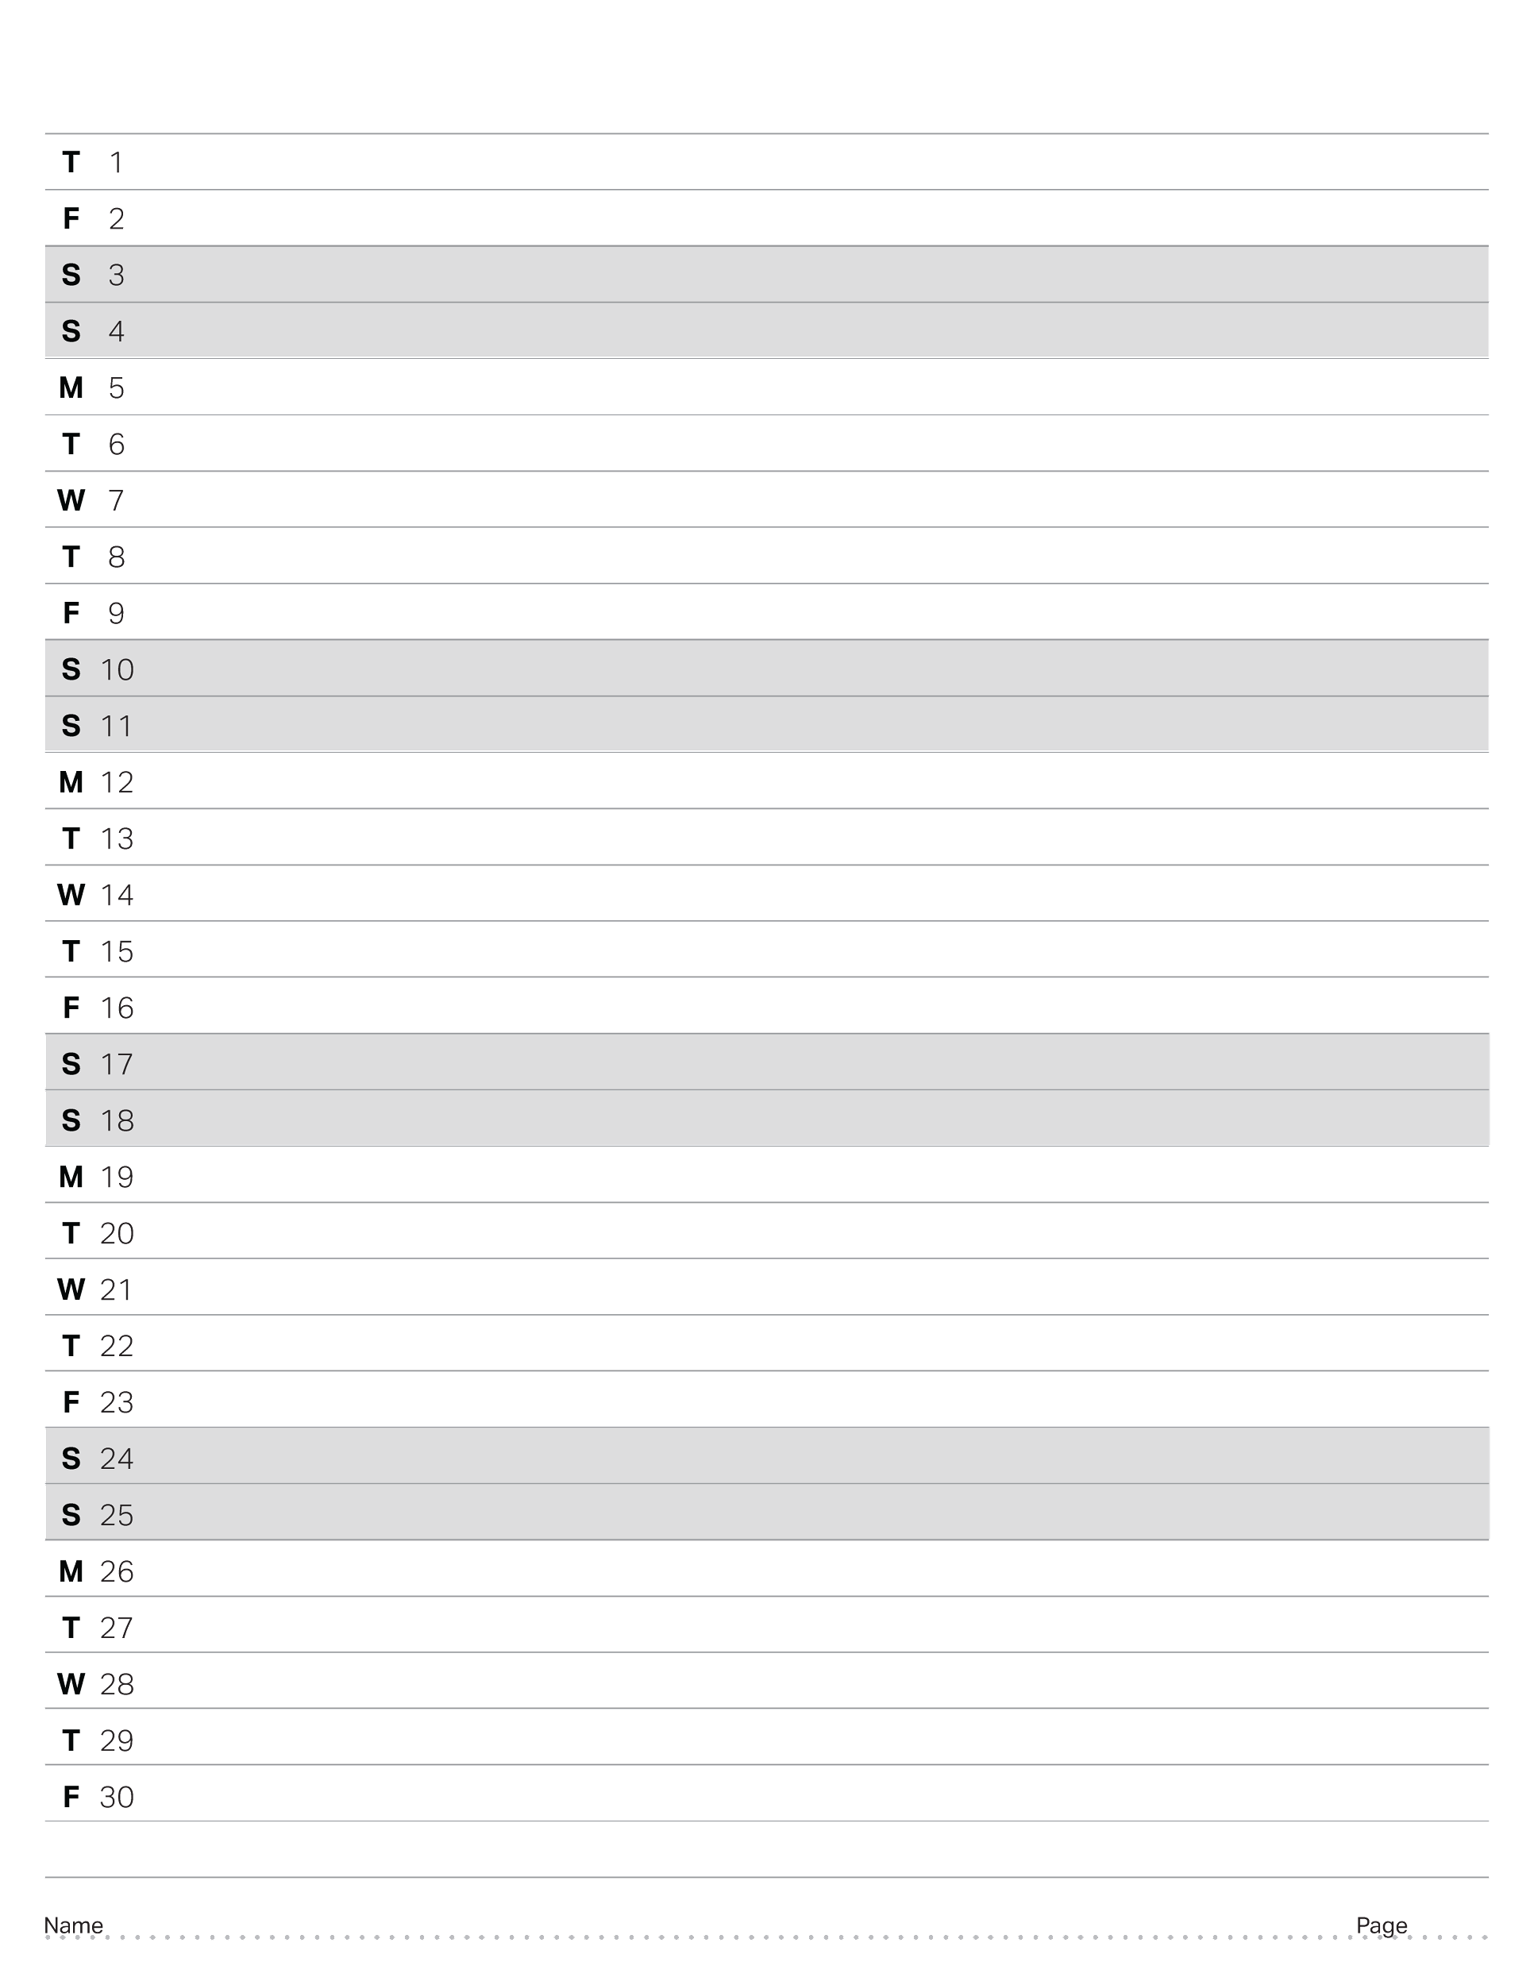
June 2023

Slide 28
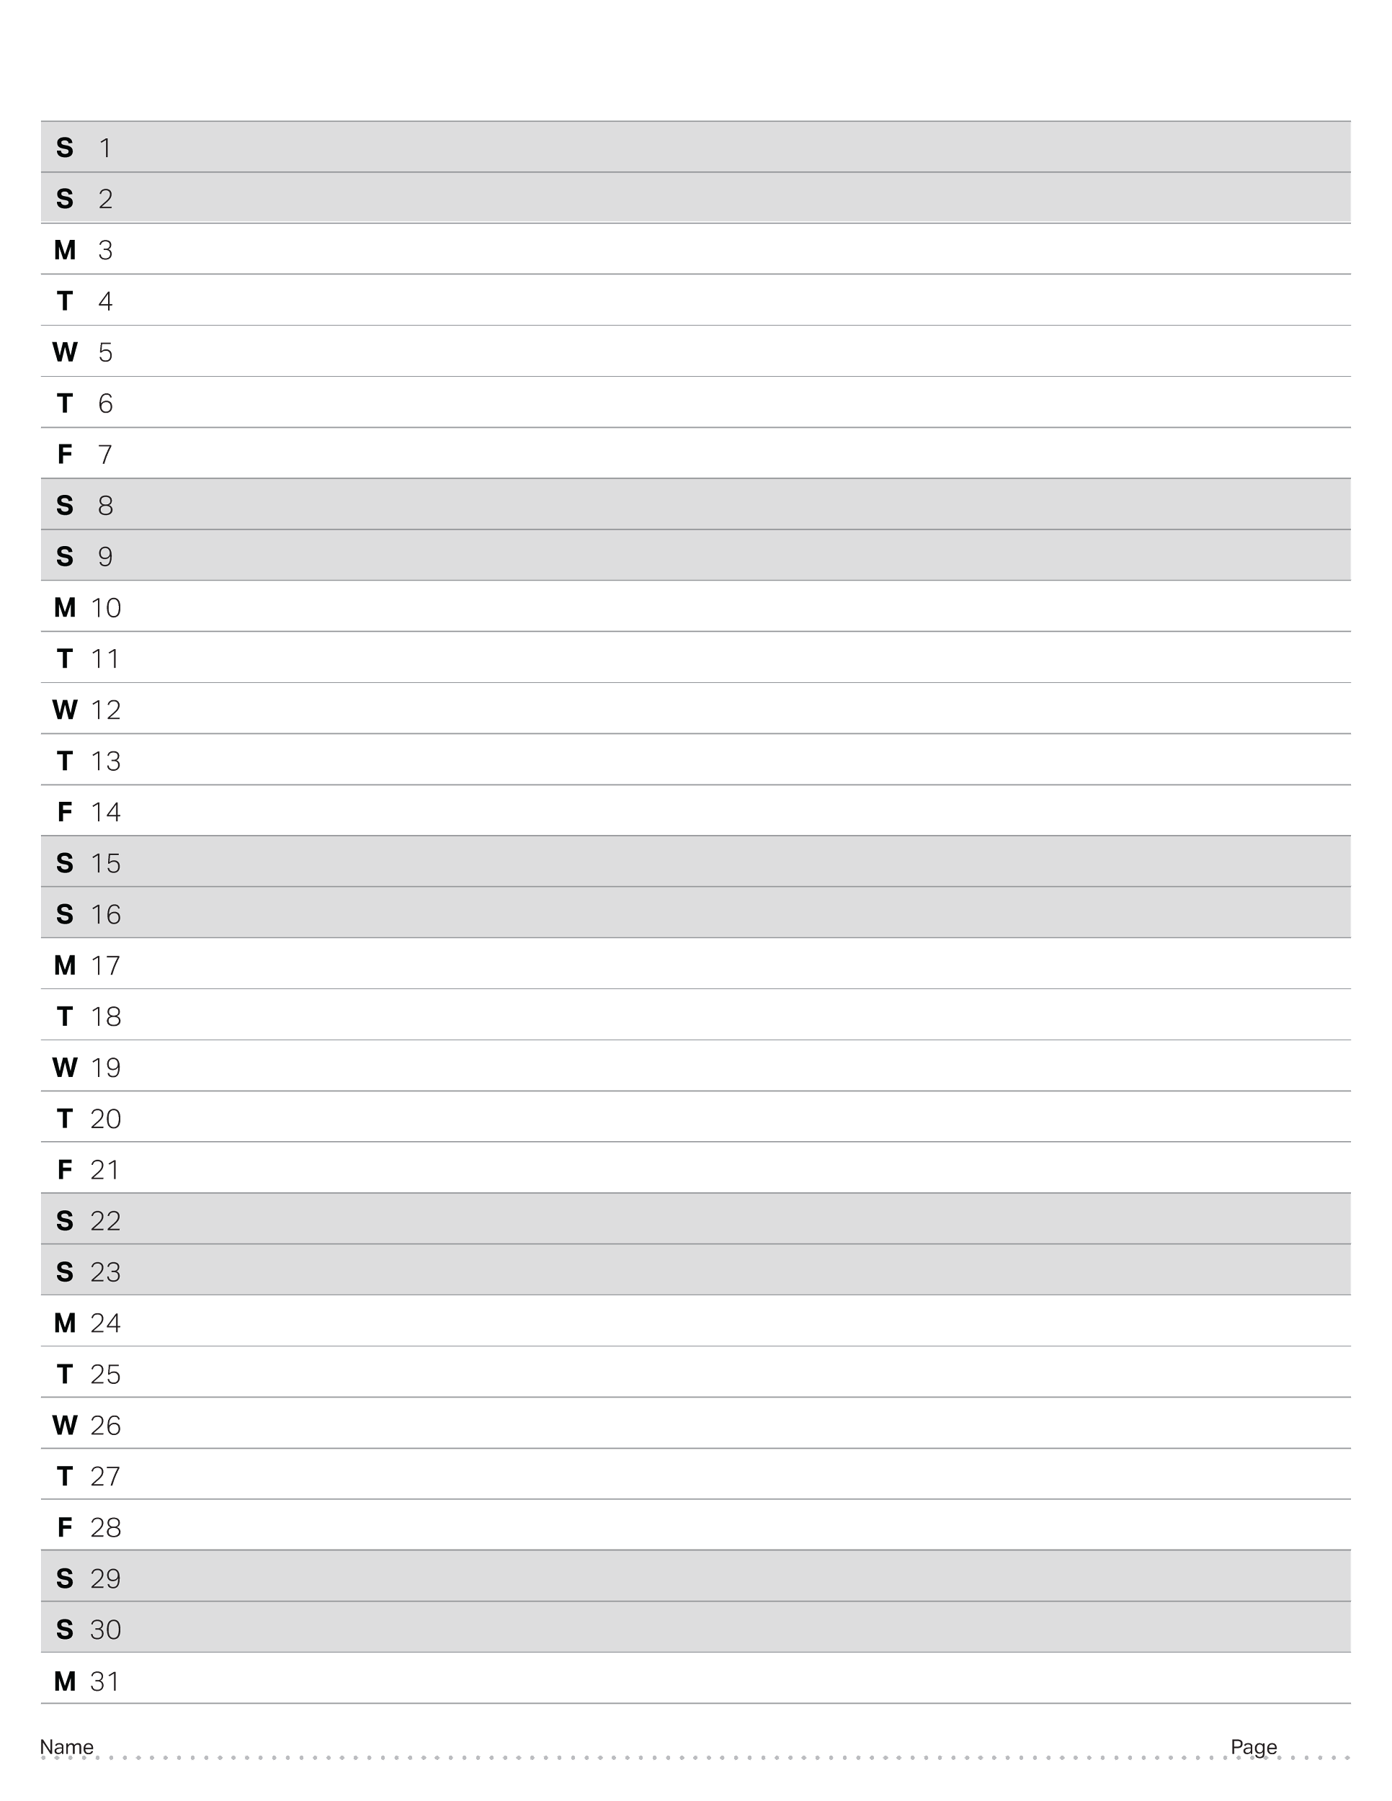
July 2023

Slide 29
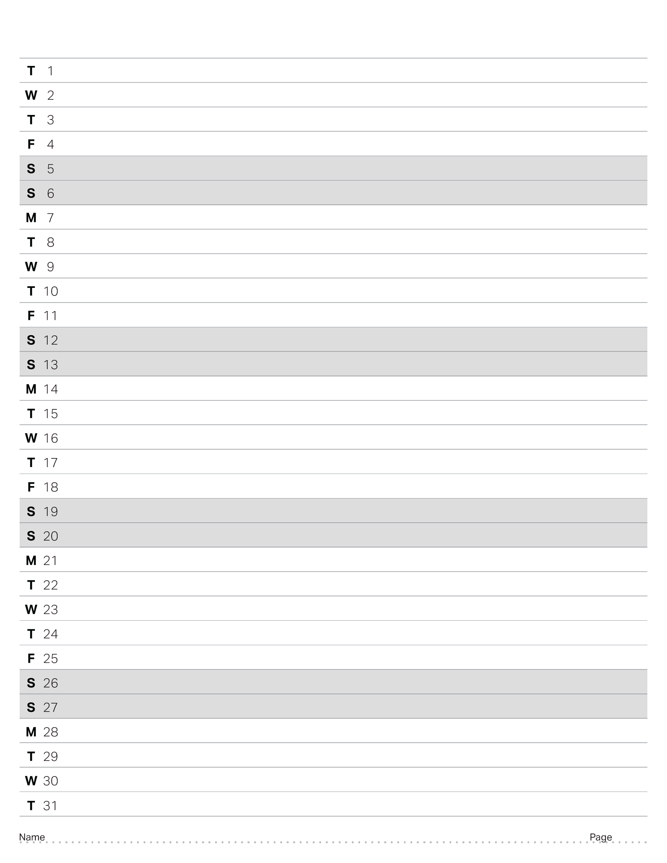
August 2023

Slide 30
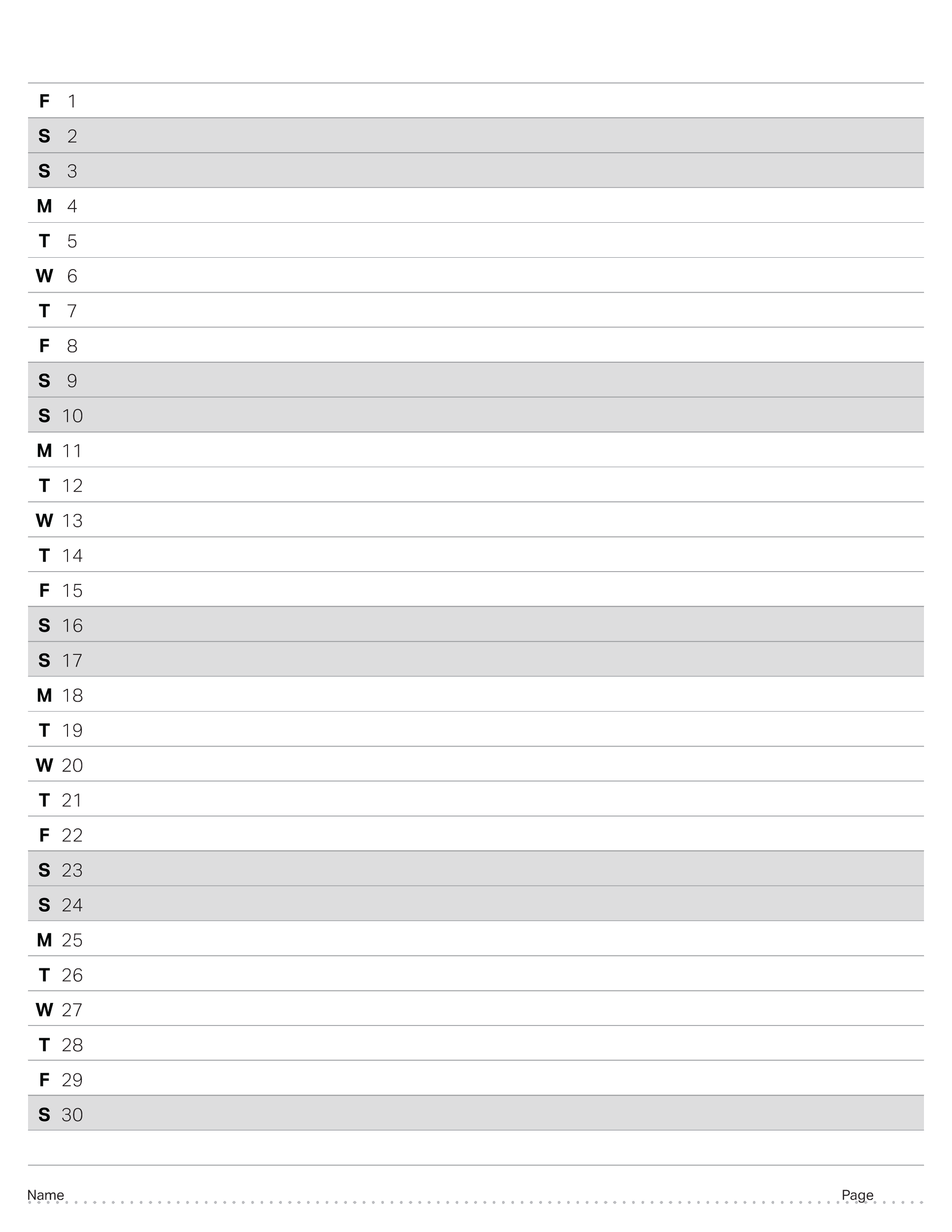
September 2023

Slide 31
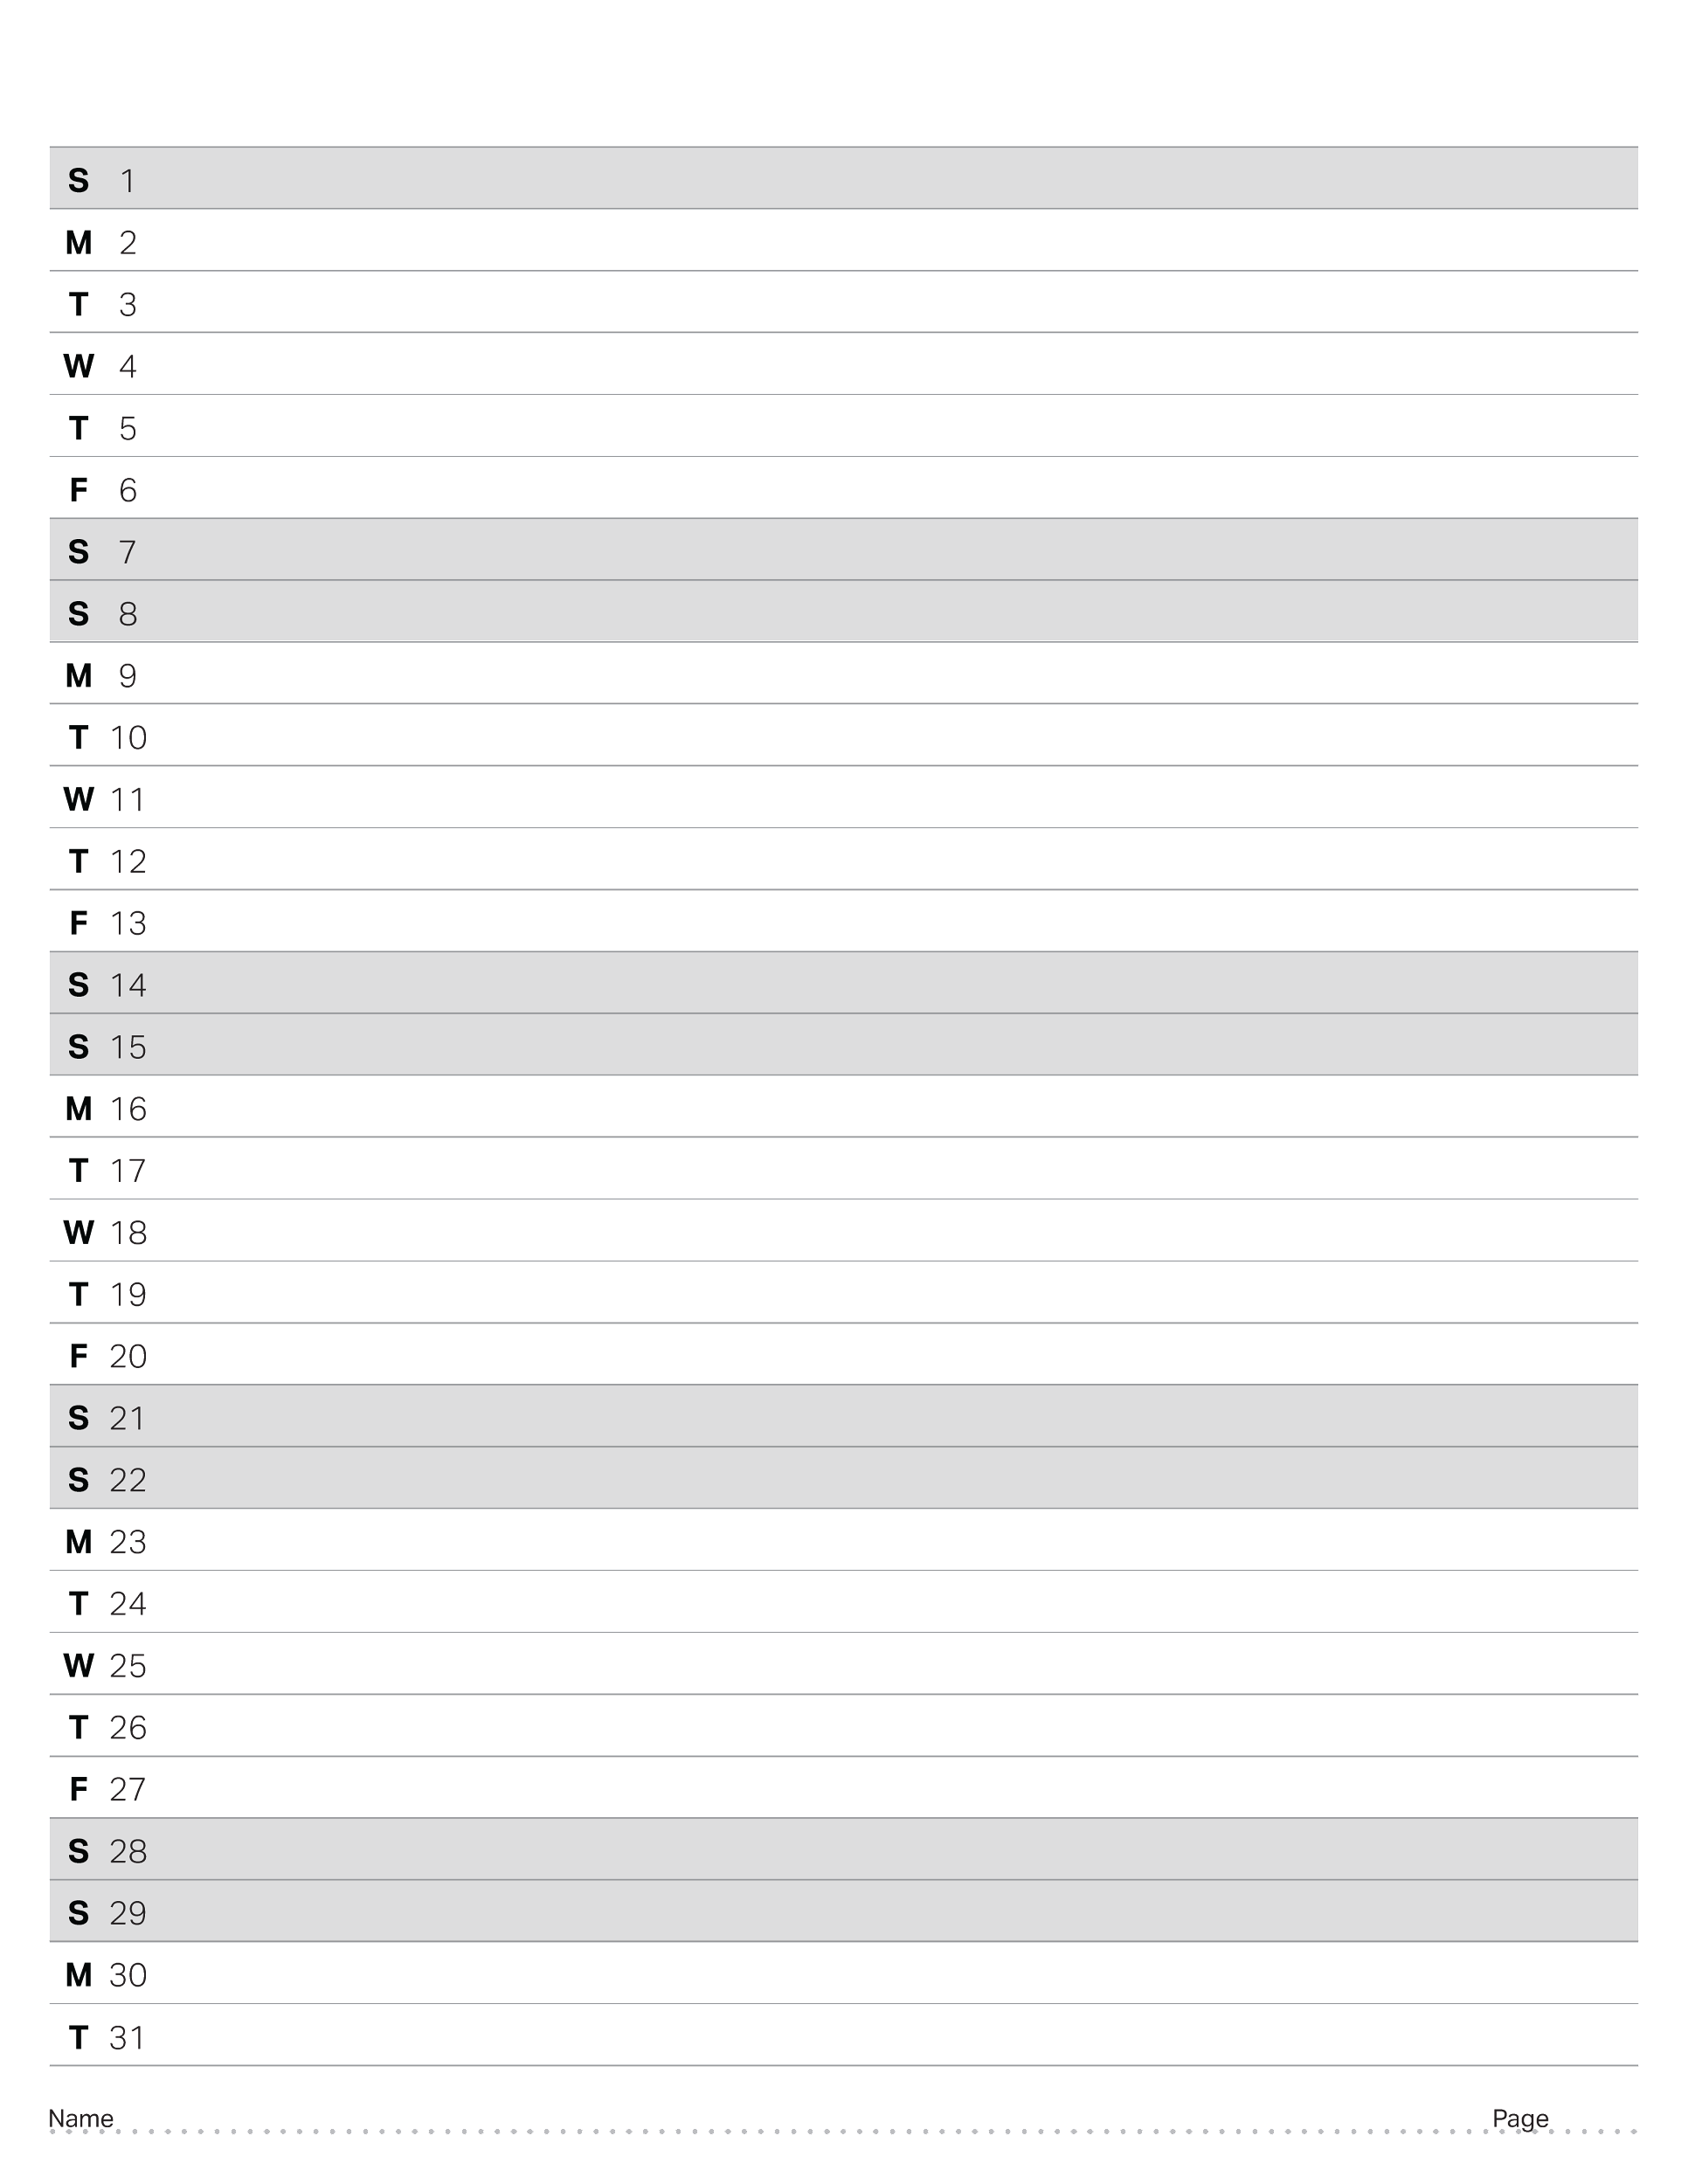
October 2023

Slide 32
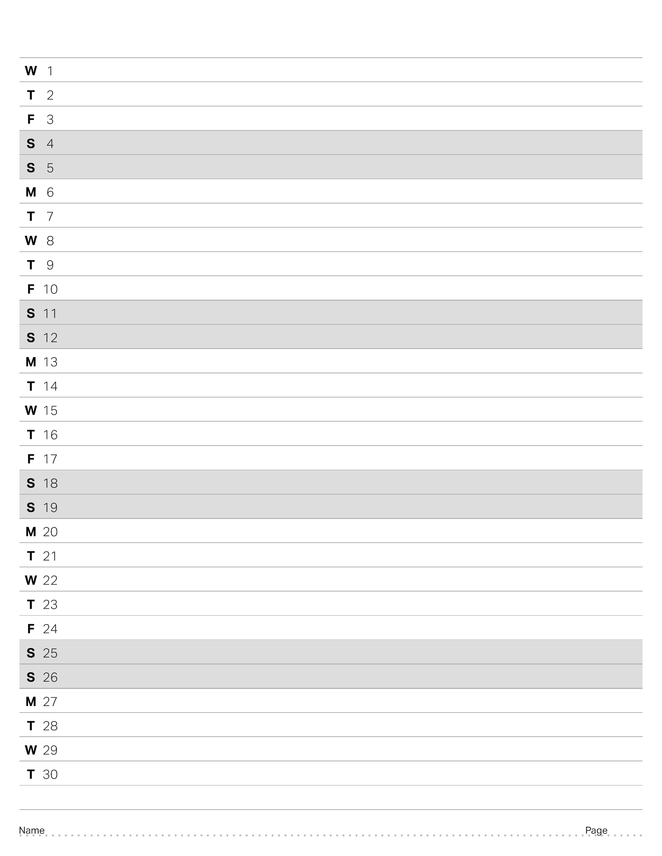
November 2023

Slide 33
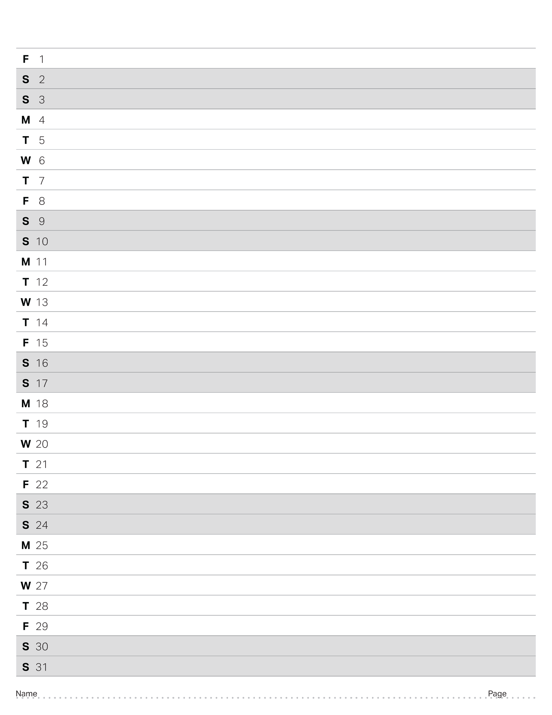
December 2023

Slide 34
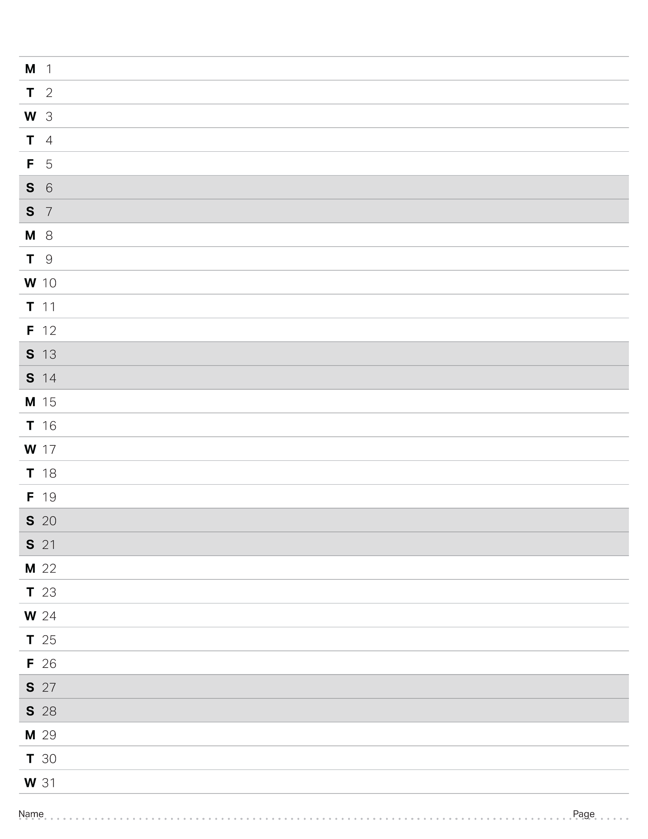
January 2024

Slide 35
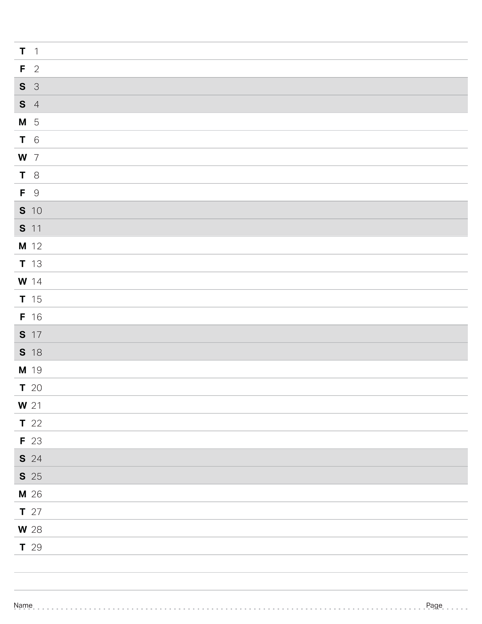
February 2024

Slide 36
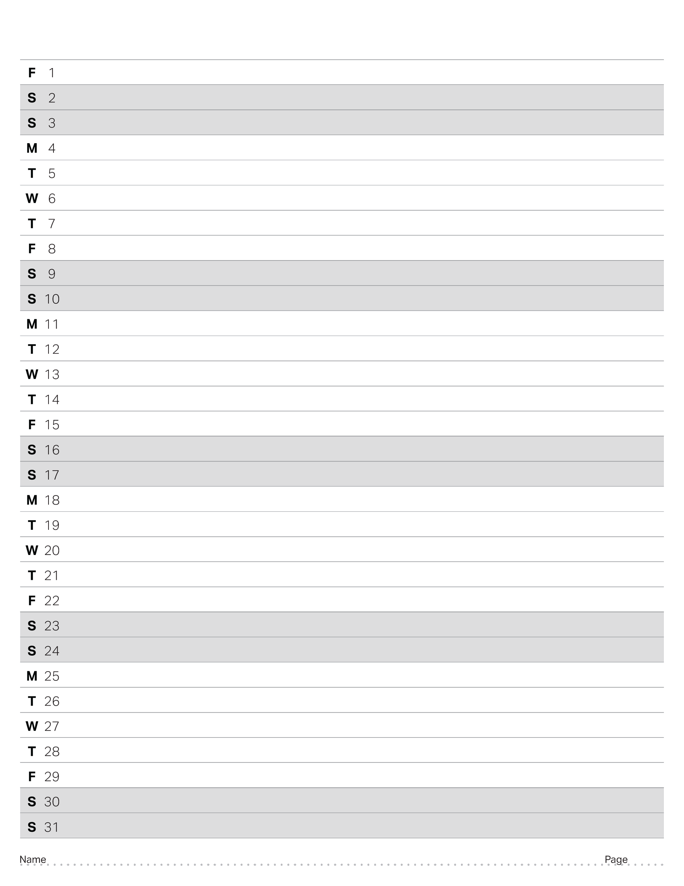
March 2024

Slide 37
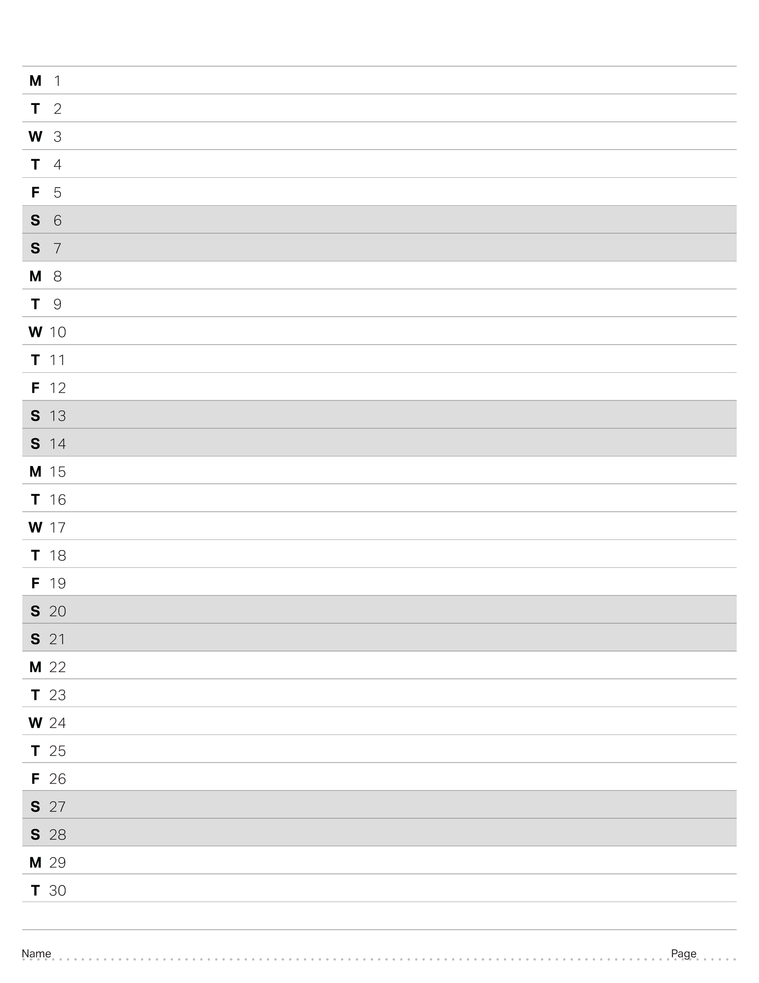
April 2024

Slide 38
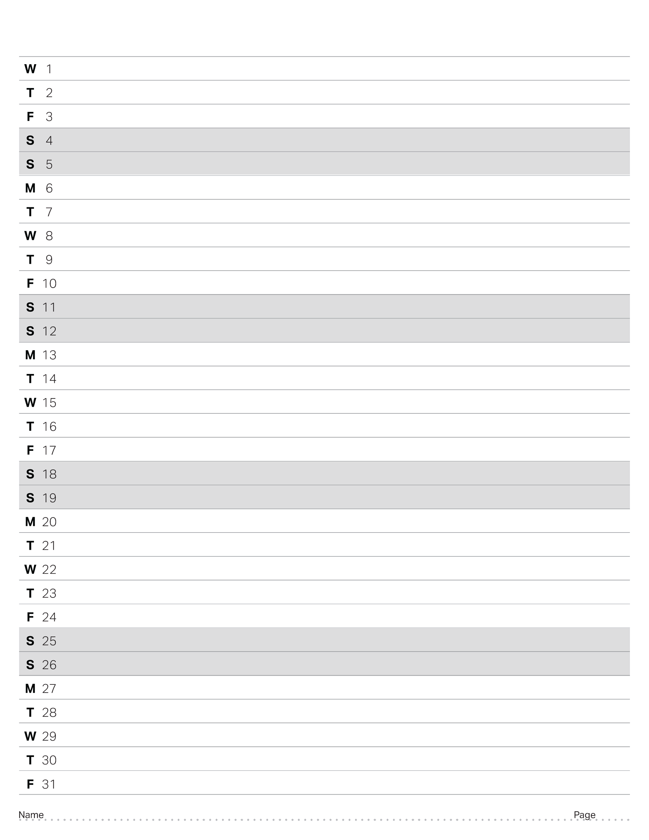
May 2024

Slide 39
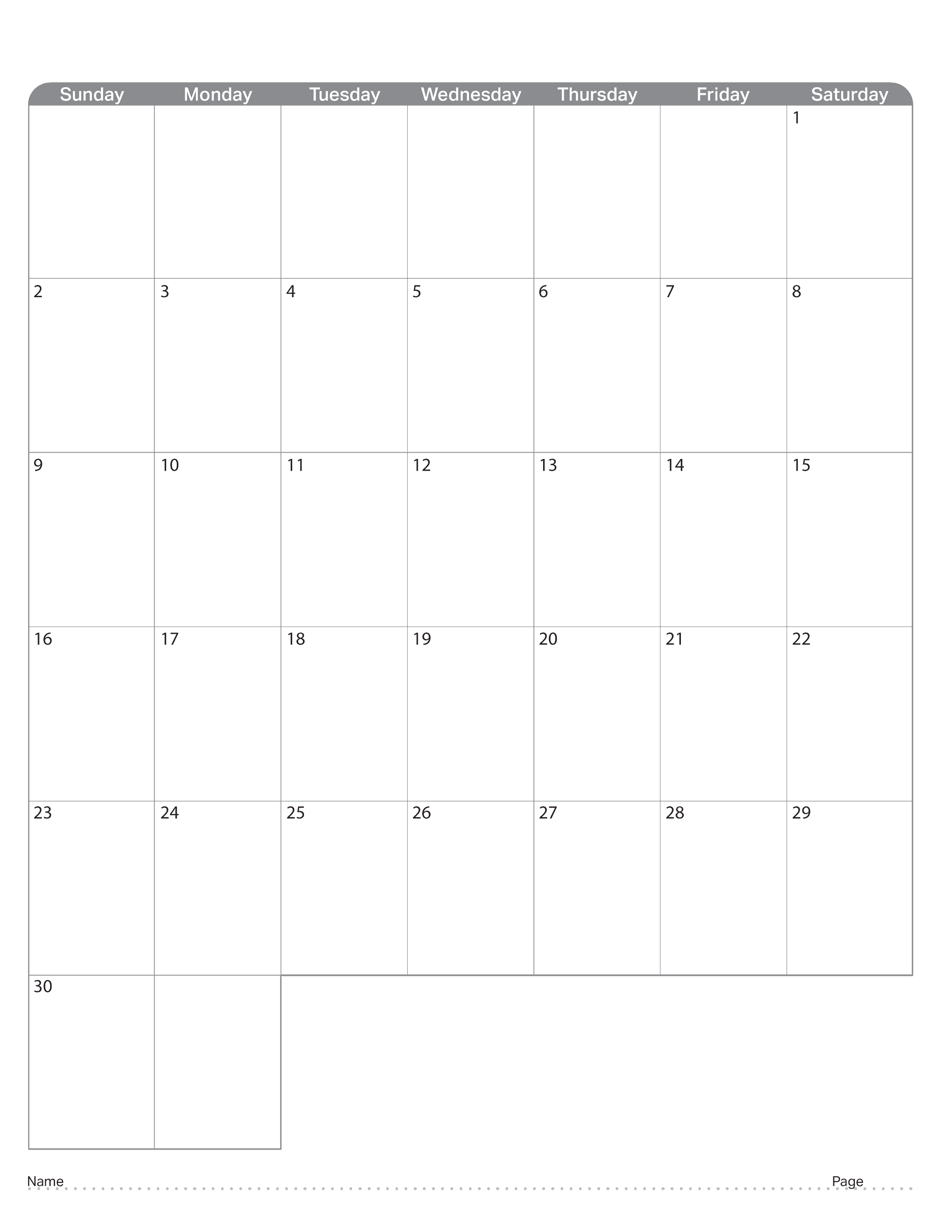
April 2023

Slide 40
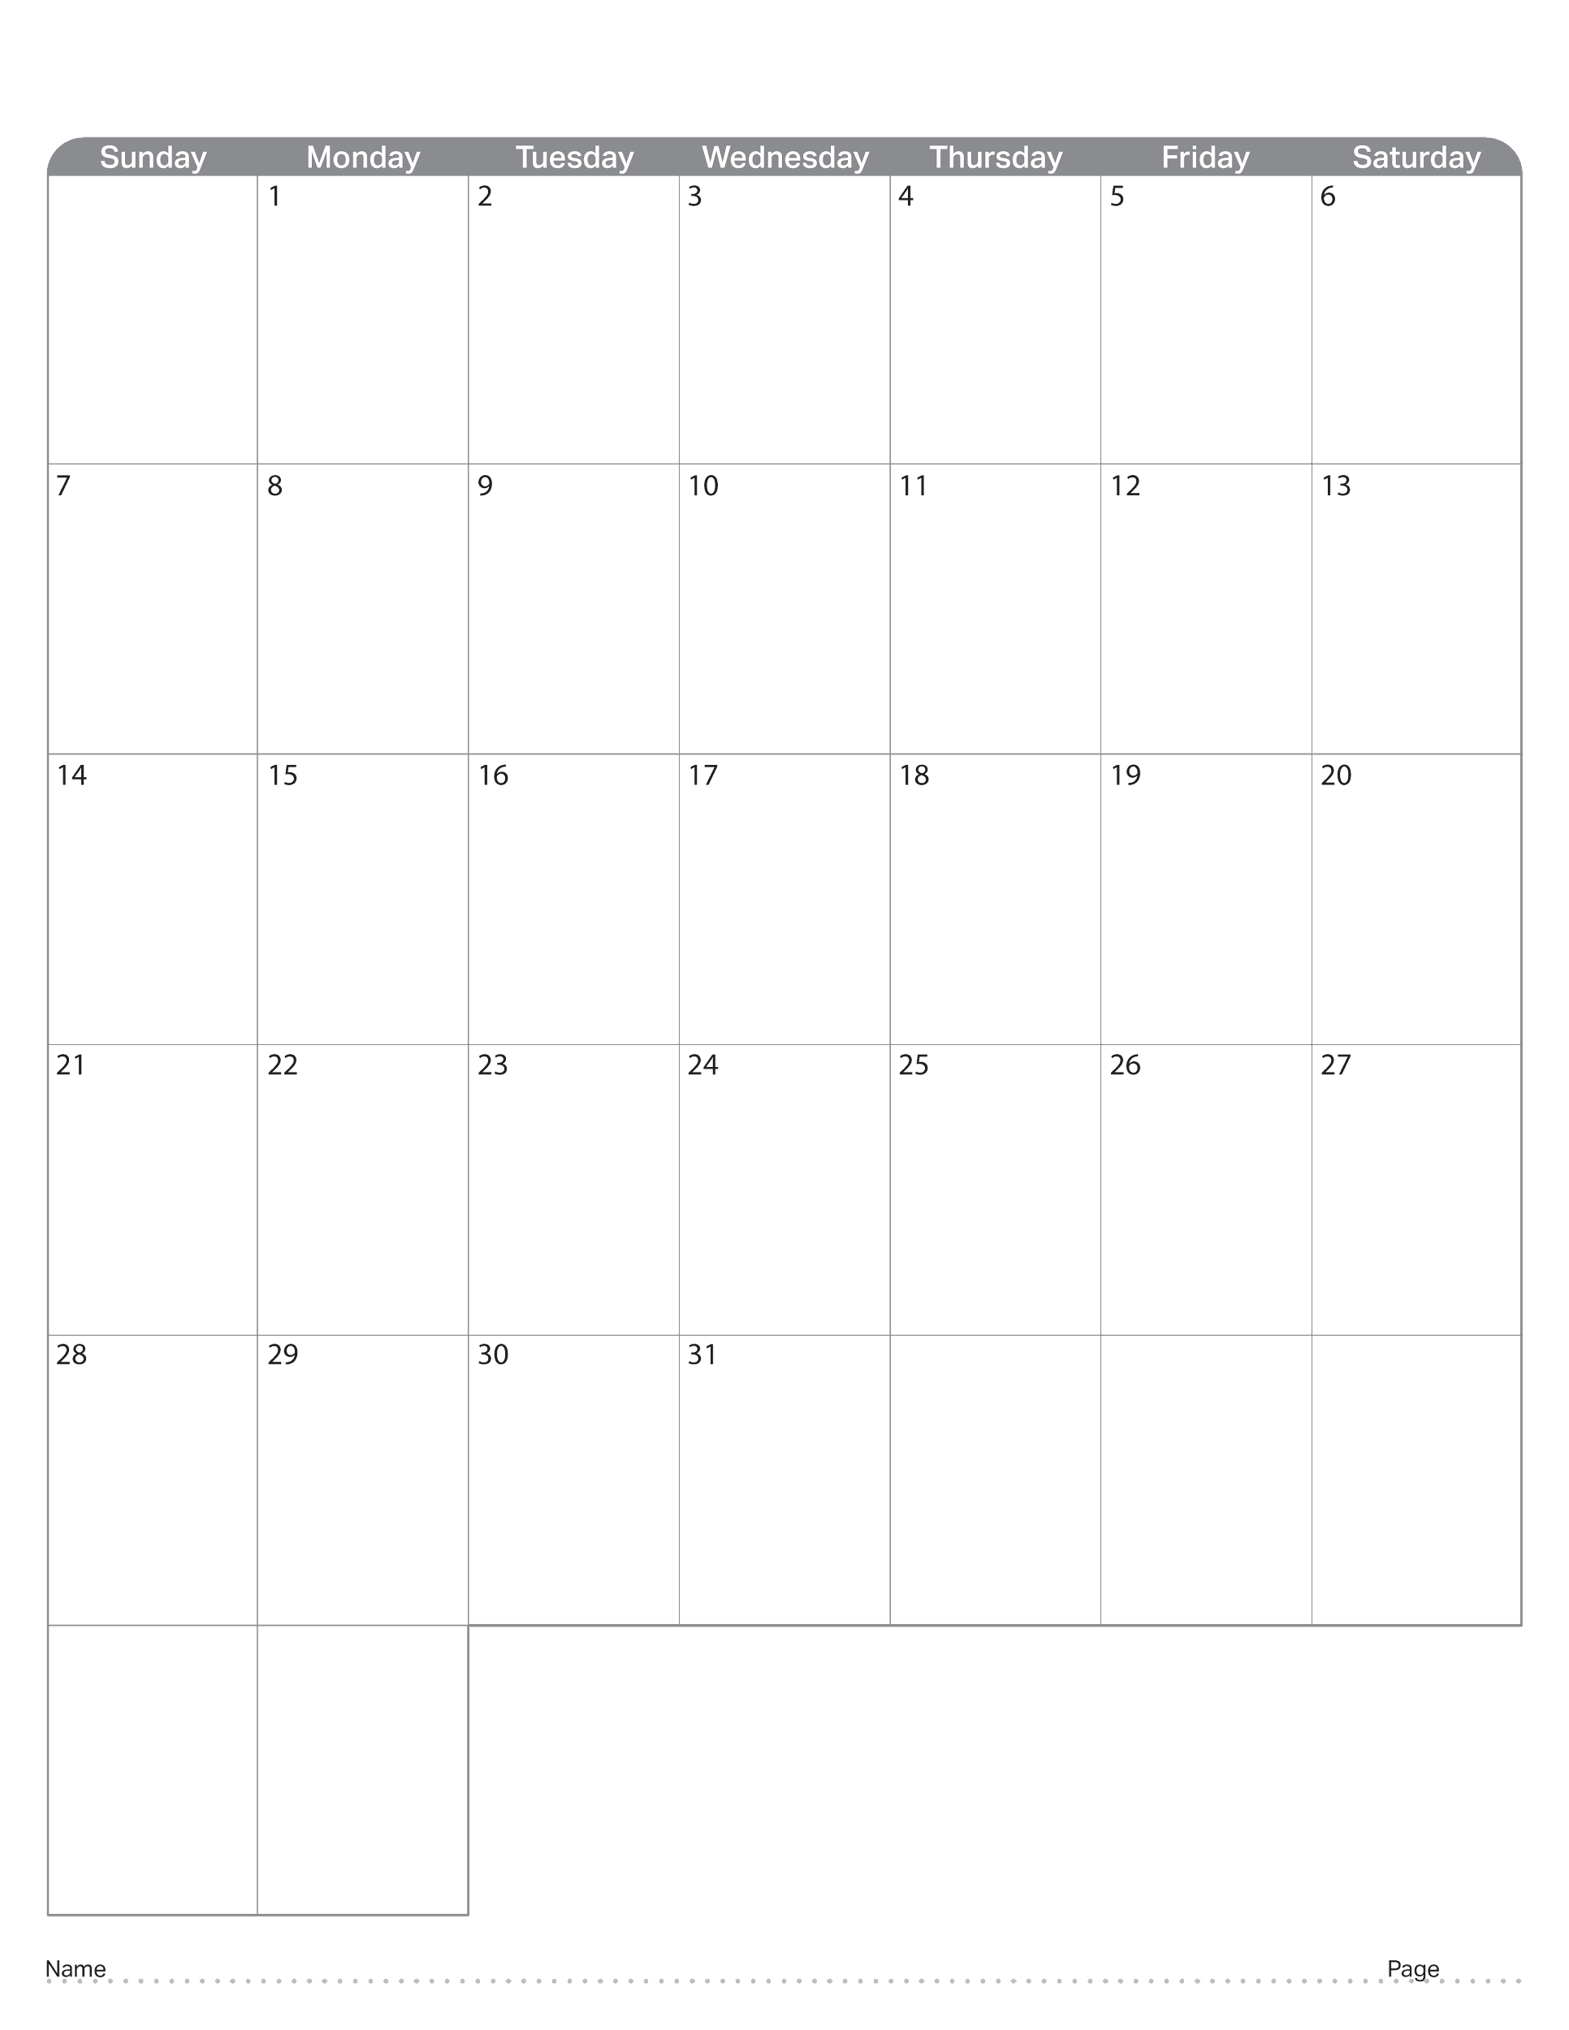
May 2023

Slide 41
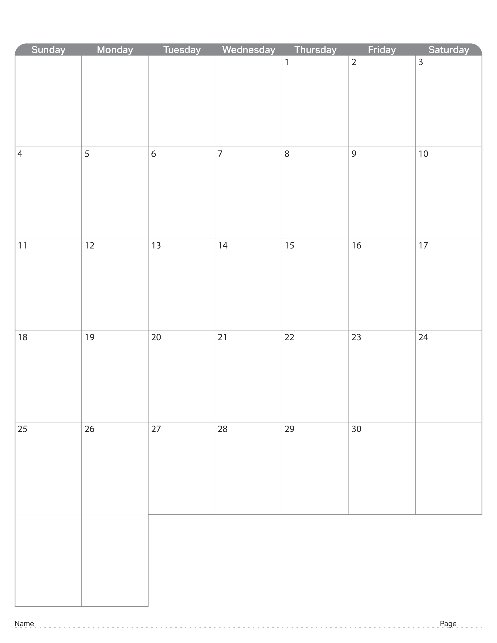
June 2023

Slide 42

July 2023

Slide 43

August 2023

Slide 44

September 2023

Slide 45
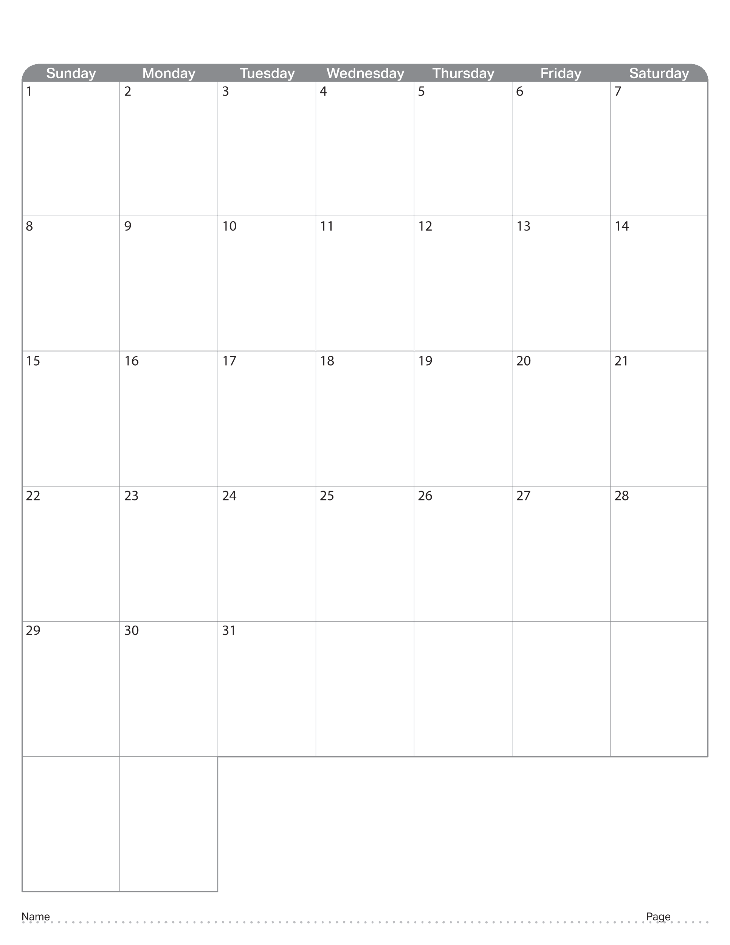
October 2023

Slide 46

November 2023

Slide 47

December 2023

Slide 48

January 2024

Slide 49

February 2024

Slide 50

March 2024

Slide 51

April 2024

Slide 52
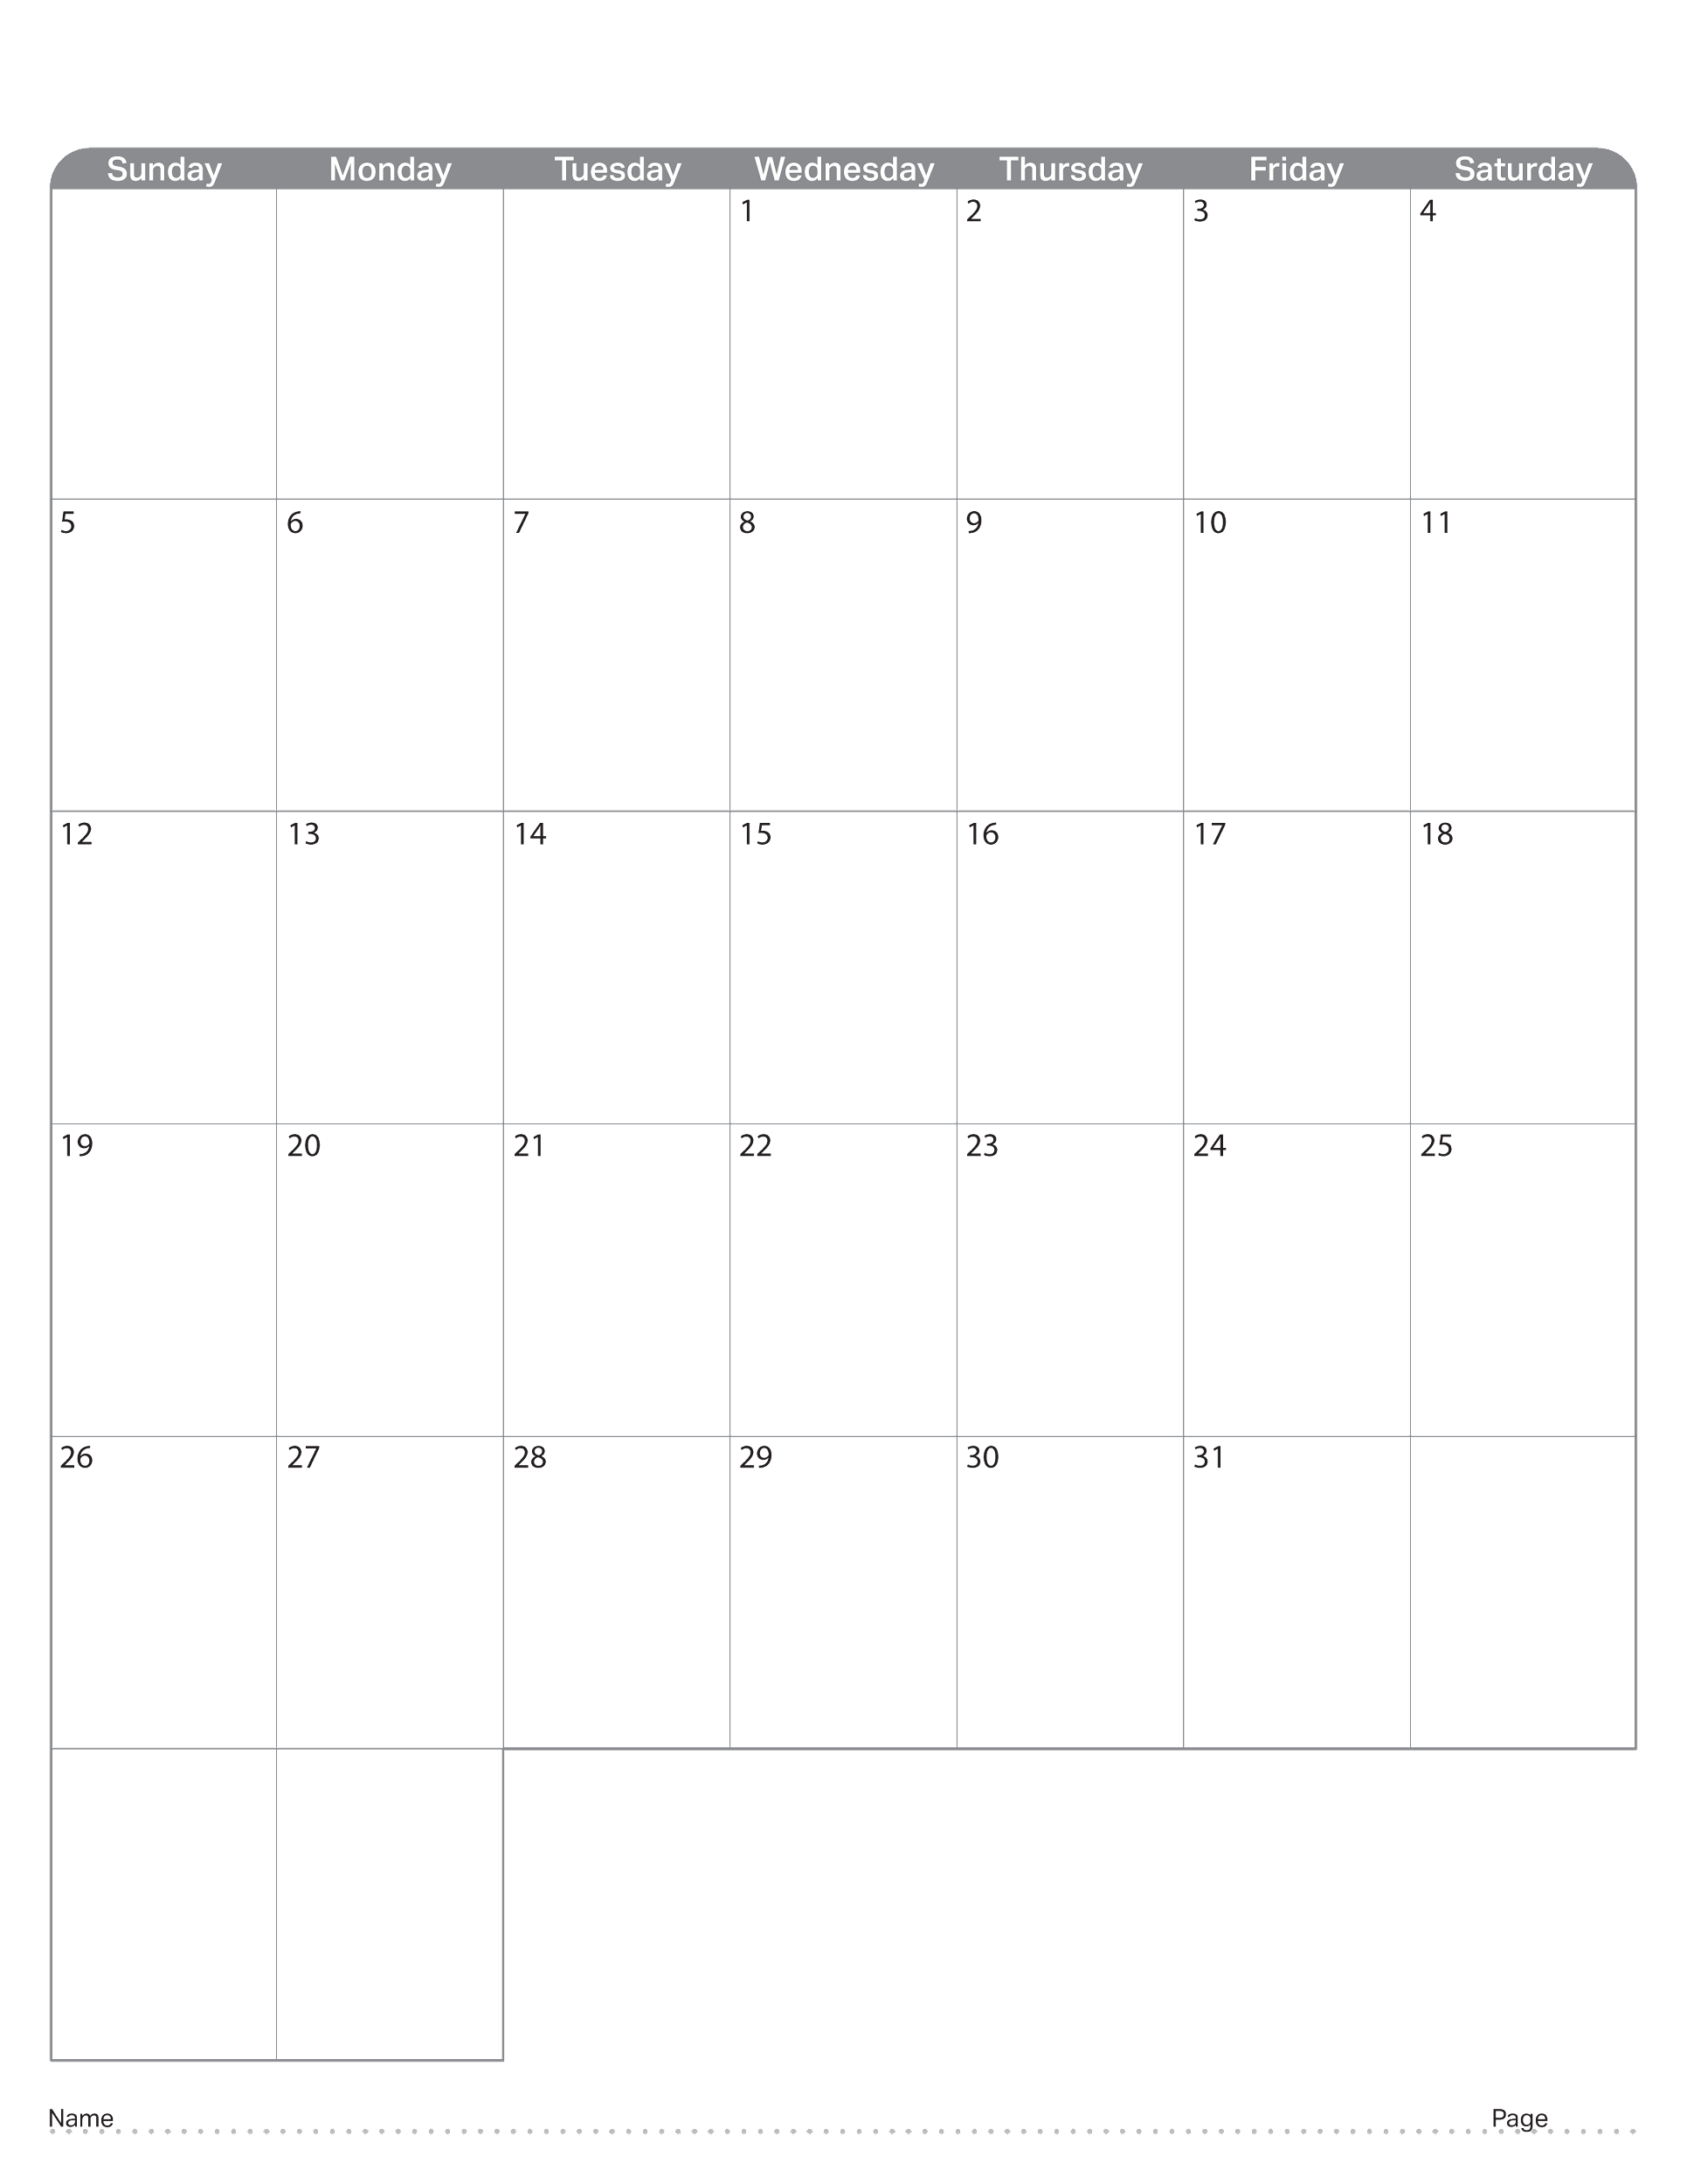
May 2024

